Slide 1
Email Automation
E-mail is the oldest form of digital communication between people and to this day, many business processes are still triggered by a simple email. We use to keep close to our inbox and there are many tasks that can be automated to help us save valuable time.
Learning Objectives:
Use the dedicated e-mail activities
Receive messages
Filter and download attachments from an email
Send e-mail messages
Use message templates
Filter with expression

Slide 2
Email Activities
UiPath.mail.activities
Activities
SMTP – Simple Mail Transfer Protocol – Sending Messages
POP3- Post Office Protocol – Reading Messages
IMAP – Internet Message Access Protocol – Read and move the messages
Exchange – Microsoft Enterprises Email Solution- Sending, Receiving, Moving, Deleting Messages
Outlook – Work with API of Desktop Application and Outlook account should be exist
Generic email activities – Save Attachment and Save mail message

Slide 3
Read Gmail Using IMAP Settings
Setting in Gmail – Go to Gmail setting, In “Forwarding and POP/IMAP” tab, just Enable IMAP
Google Account – Go to “Manage your Google Account” ,Then Turn on “Less Security App Access”
Outlook Methods -https://docs.microsoft.com/en-us/office/vba/api/outlook.items.find

Slide 4
E-mail Automation - Practice 1
Create a workflow that reads the Inbox and sorts the emails by moving them to various folders, based on “rules” defined in an Excel similar to the one in the attachment.
If the sender address contains the String defined in the Sender column, move the mail to the email folder defined in the Folder column.
Download resource file attached.

Slide 5
E-Mail Automation - Practice 2
Create a workflow that:
Reads the 6th page of "Session 11 - exercise 2 - UiPathOrchestratorAzureInstallationGuide2016.1" (in the attachment)
Reads the 2nd page of "Session 11 - exercise 2 - ScannedDoc" (in the attachment)
Sends an email with both documents attached and with the text from point 1 and text from point 2 as Body
Download exercise file attached.

Slide 6
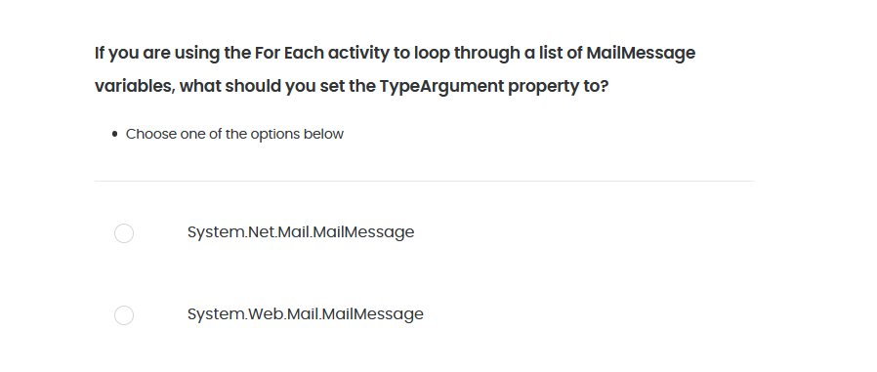
Quiz 01/05

Slide 7
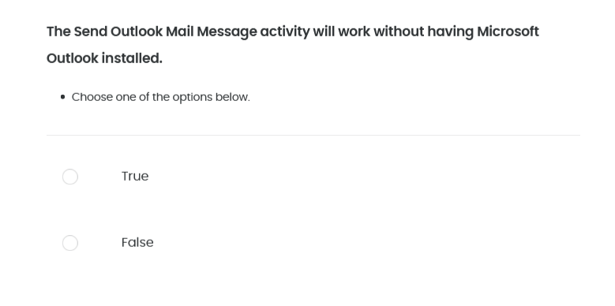
Quiz 02/05

Slide 8
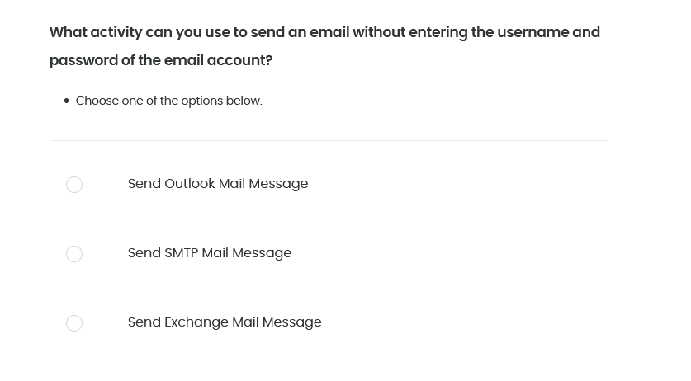
Quiz 03/05

Slide 9
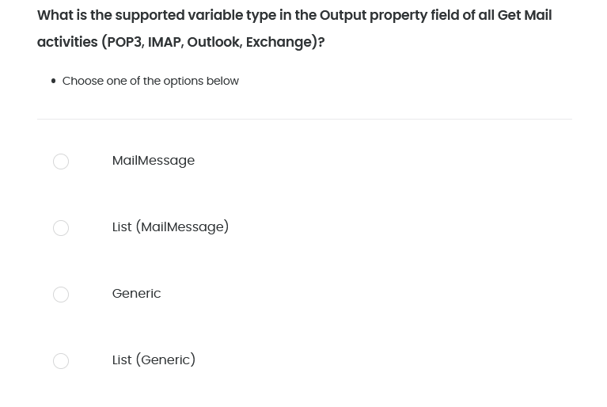
Quiz 04/05

Slide 10
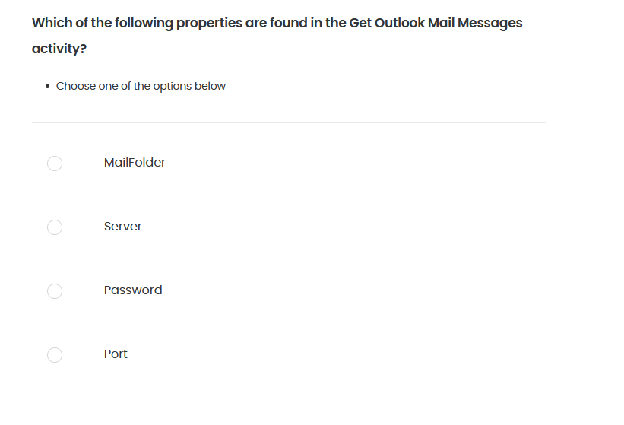
Quiz 05/05

